Slide 1
Split-belt dynamics literature + metrics
July 2023

Slide 2
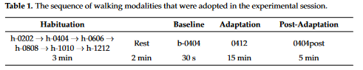
Dynamic Asymmetries Do Not Match Spatiotemporal Step Asymmetries during Split-Belt Walking
Scarano, Tesio, Rota, Cerina, Catino, Malloggi
MDPI 2021
0.4 /1.2 m/s (dominant is fast leg)
Spatiotemporal step parameters, ankle power, ankle work, mean velocity of centre of mass
Faster side has increased ankle power and ankle work increased and step length and stance time decreased, COM velocity decreased slightly
Propuslion (7-11)
Spatiotemporal and kinematic symmetry may conceal dynamic asymmetries
Alterations of lower limb joint dynamics (26)
N = 12; Joint kinematics optoelectronic, Davis anthropometric model (30);
Tied walking habituation at several velocities 3 min at speeds between 0.2 and 1.2, rest 1-2 min, baseline 30s at 0.4 , split 15 min, post adaptation 5min
Initial strides 7-12
Late strides last 6
Velocity of CoM: on each stride CoM velocity = (fast belt velocity * % stride time of stance on that belt) + (slow belt velocity * % stride time of stance on that belt)
Joint power = joint torque * joint rotation speed (power is positive/generated when torque and rotation are in the same direction
Asymmetries were log linearized (7, 23)
Define adaptation to be complete after 7 strides

Slide 3
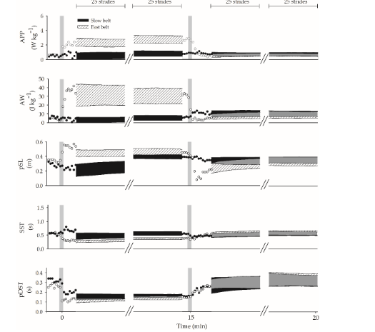
Dynamic Asymmetries Do Not Match Spatiotemporal Step Asymmetries during Split-Belt Walking
APP ankle peak power – increased on fast belt and after adaptation increased slightly on both sides
AW ankle work – ankle work increased in fast and slight increase in slow
pSL posterior step length
SST single stance time
pDST posterior double stance time

Slide 4
Large propulsion demands increase locomotor adaptation at the expense of step length symmetry
Sombric, Calvert, Torres-Oviedo
2019
EXTENSIVE NOTES IN ZOTERO
Find faster step length adaptation in incline walking – note unilateral differences (propulsion is adapted in slow leg on incline, braking is adapted in fast leg on decline)
Incline may increase salience of speed difference (greater percieved difference accelerates adaptation Hookgamer 2015)
The augmented propulsive force may drive aftereffects (potentially one or both of AJ’s papers address this?)
The higher energetic cost of incline walking may make participants more sensitive to changes in metabolic cost associated with asymmetry (metabolic cost work done by Finley 2013) and the sensitivity test done by me
Is faster adaptation in incline the result of greater sensitivity to the metabolic costs of asymmetry? This is my gap in the literature
Leg orientations – unilateral adaptations and contralateral relationships between legs during adaptation and aftereffects are occluded by asymmetry metrics
Step length adaptation is mostly in the fast leg
In incline group propulsion adaptation is primarily in the slow leg
In decline braking adaptation is primarily in the fast leg
Subjects on incline overshot symmetry (incline as a short cut to the past symmetrical adaptation observed by Sanchez 2019?)

Slide 5
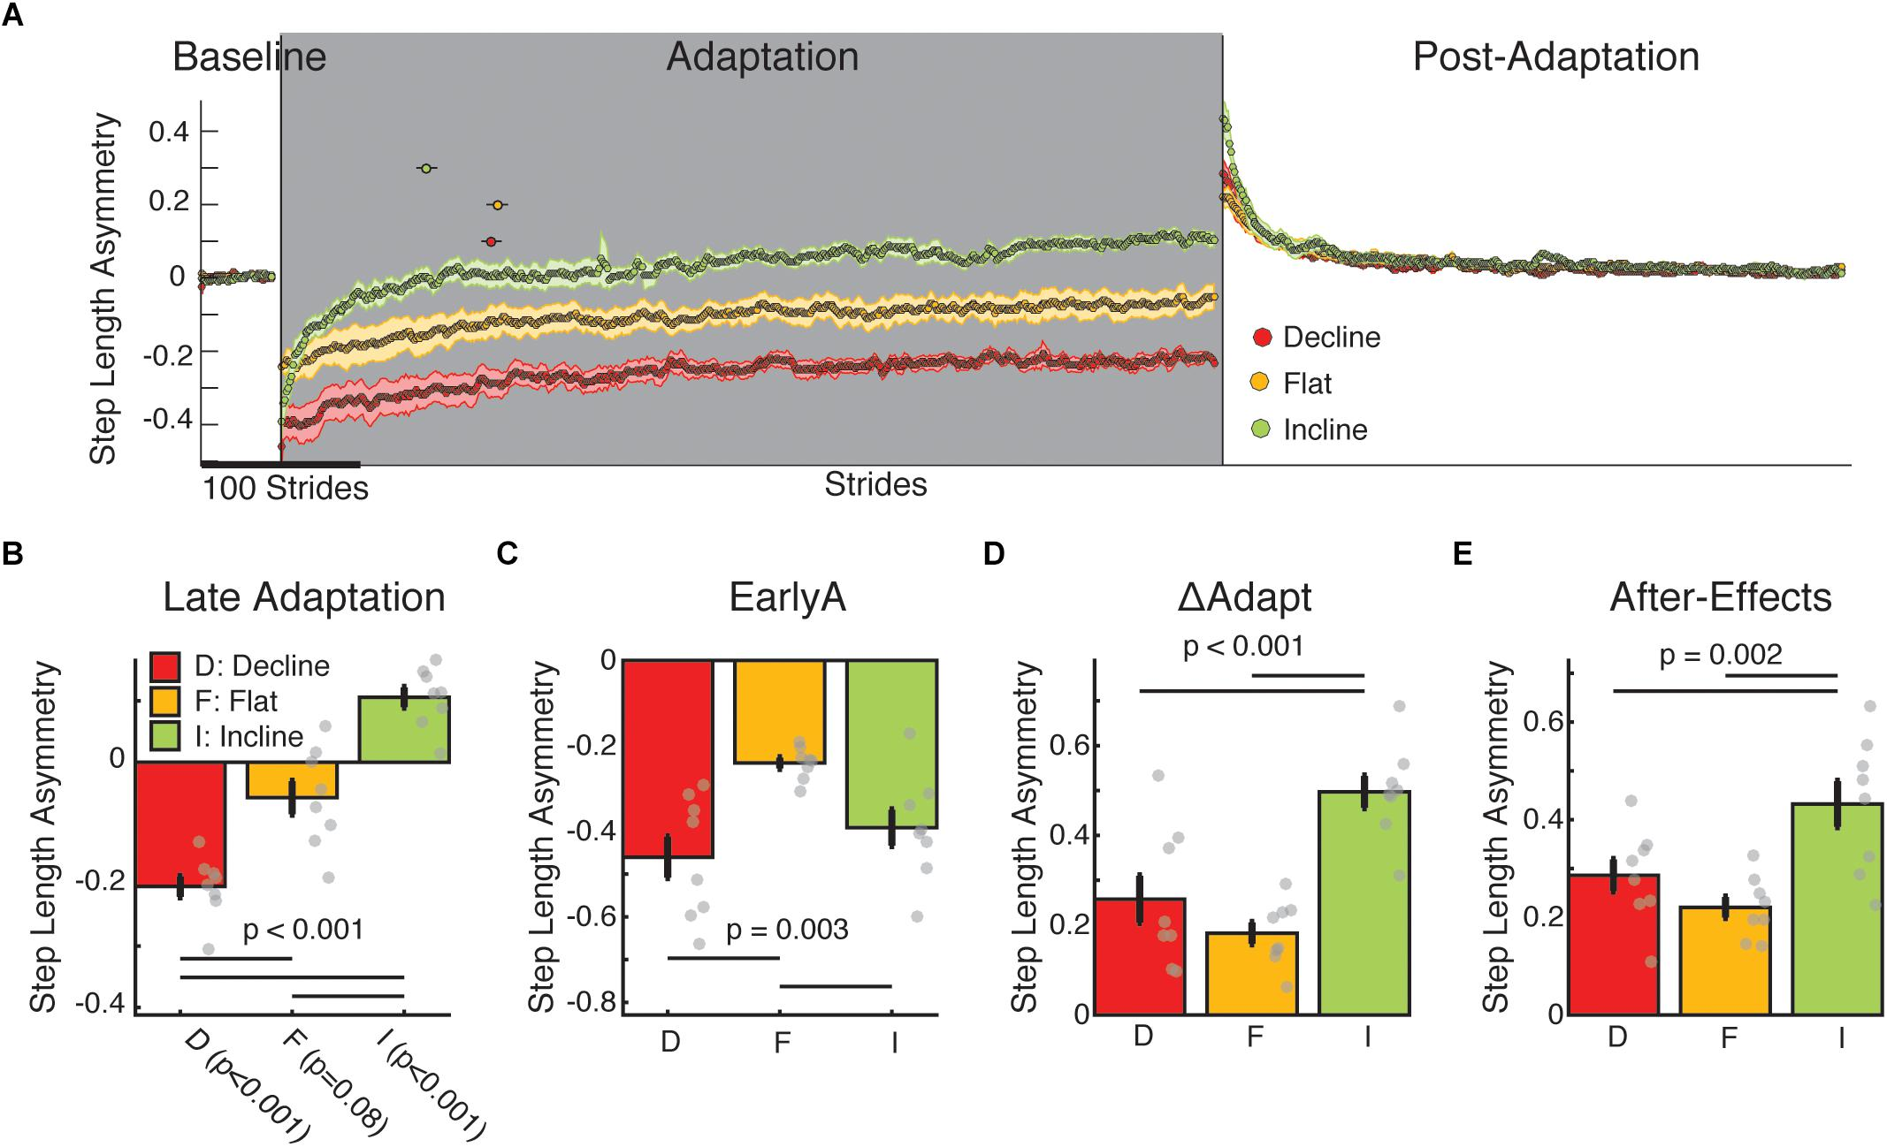
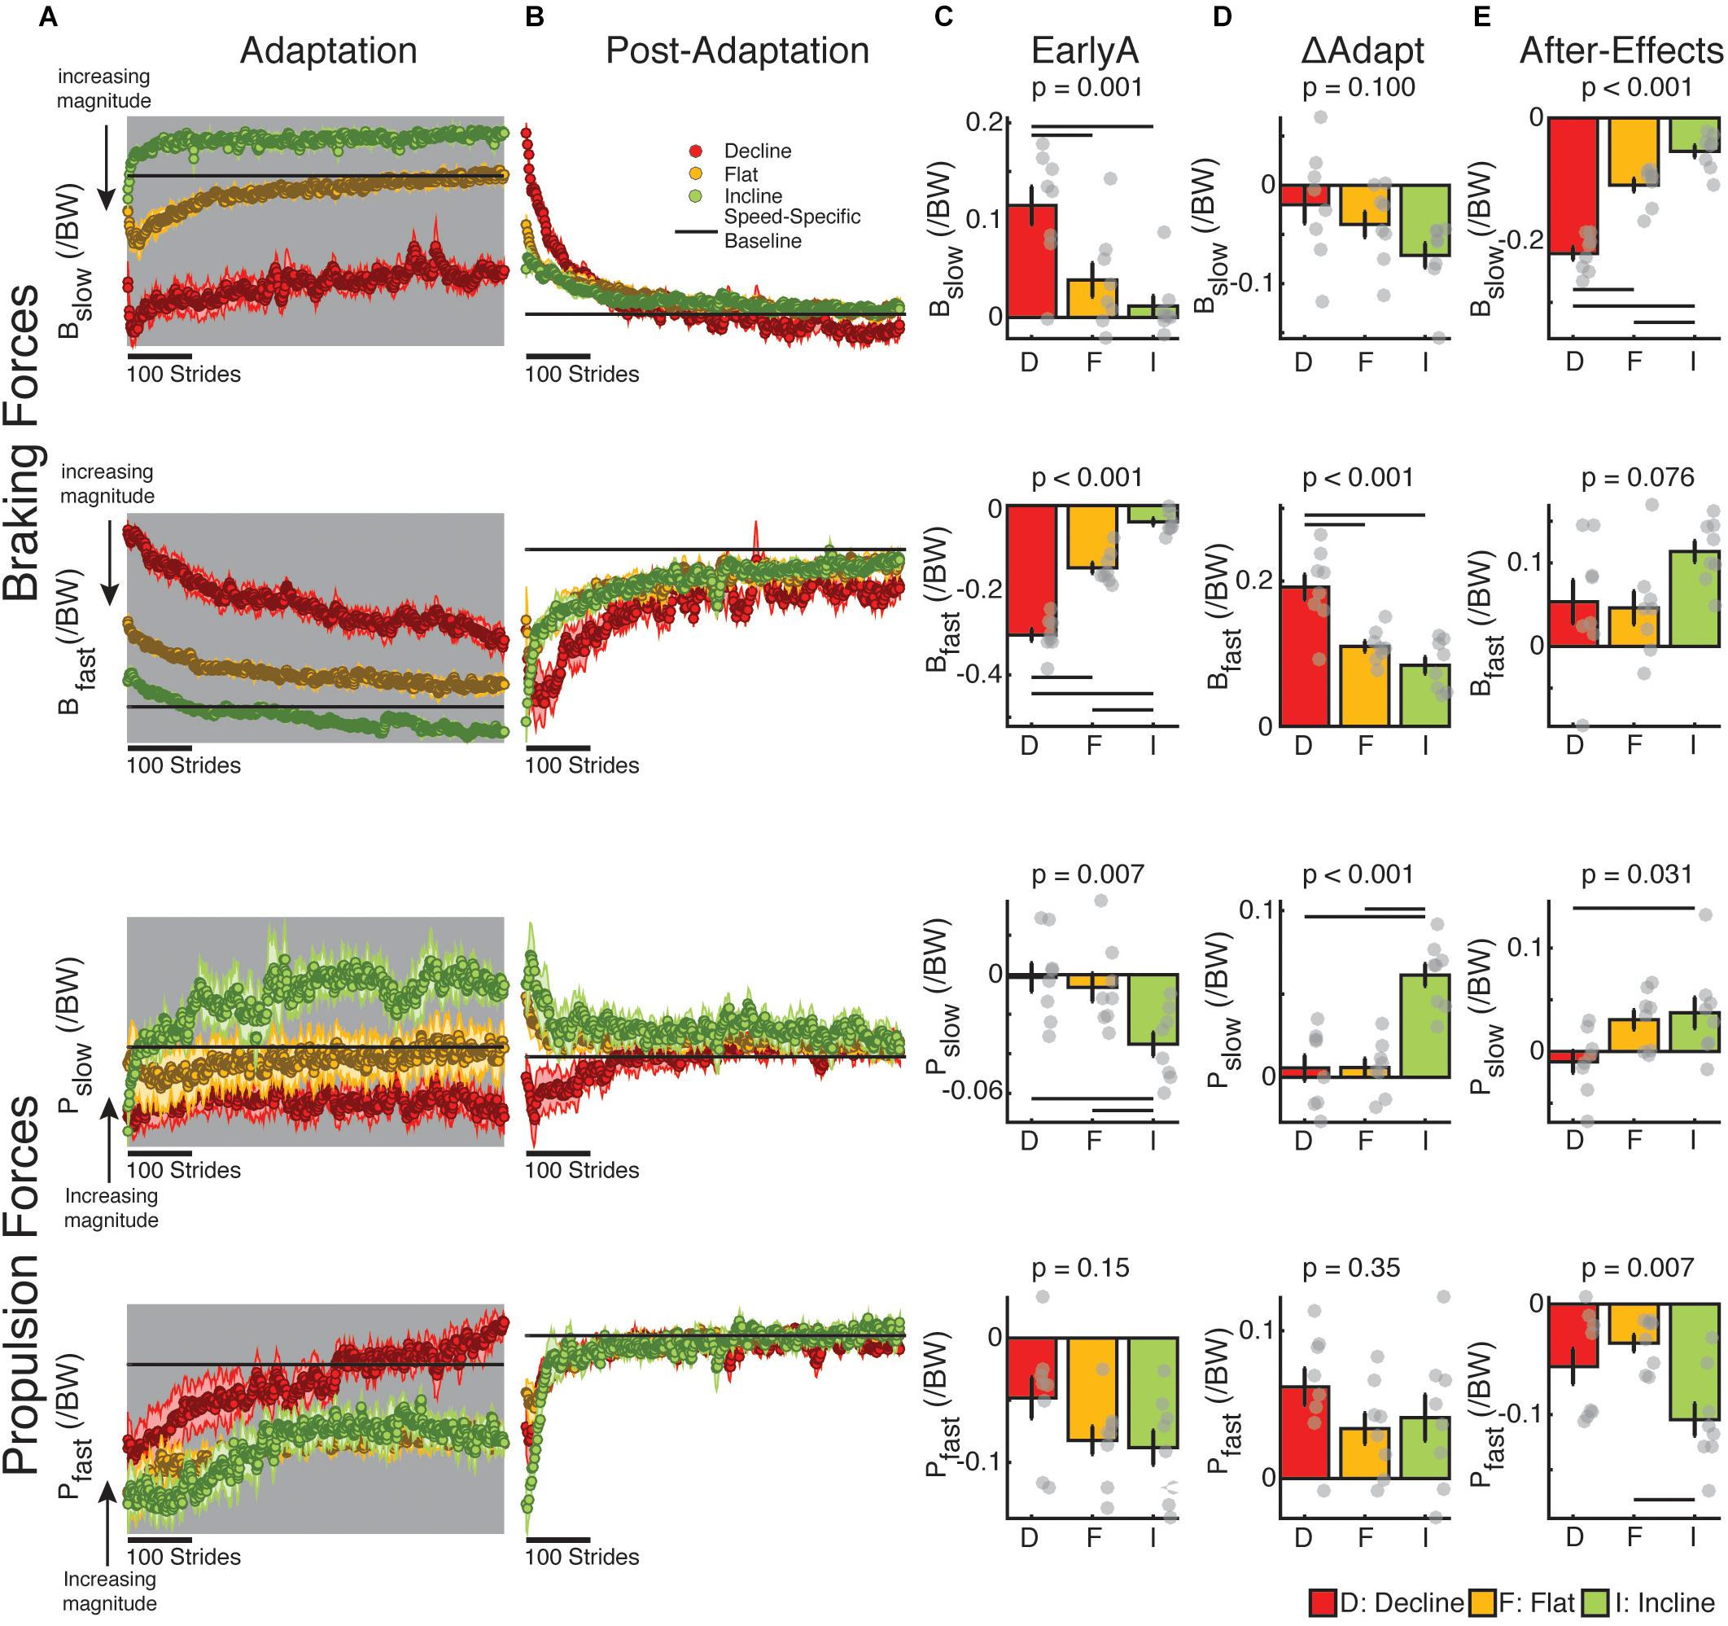

Slide 6
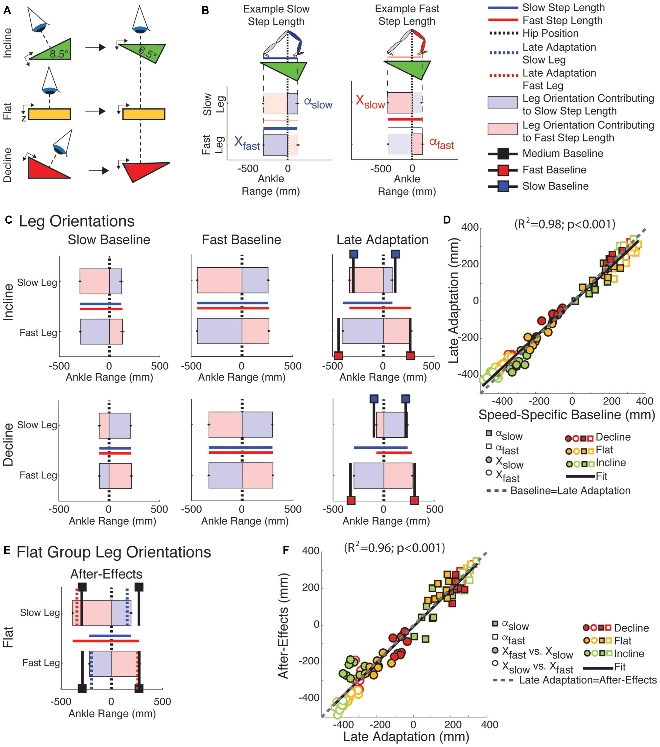
Leg orientations with respect to the hip – participants recover the leg orientation of the matching baseline speed during adaptation (ie fast leg returns to fast baseline orientation while slow leg returns to slow leg orientation)

Slide 7
To compare my data to this paper
Figure need to make : compares fast leg between effort conditions and slow leg between effort conditions for braking and propulsion forces
A single panel will show braking for the fast leg in high, low, control
“” braking for slow leg
“” propulsion for fast leg
“” propulsion for slow leg
Calculate leg orientation metrics – are there differences between effort groups?

Slide 8
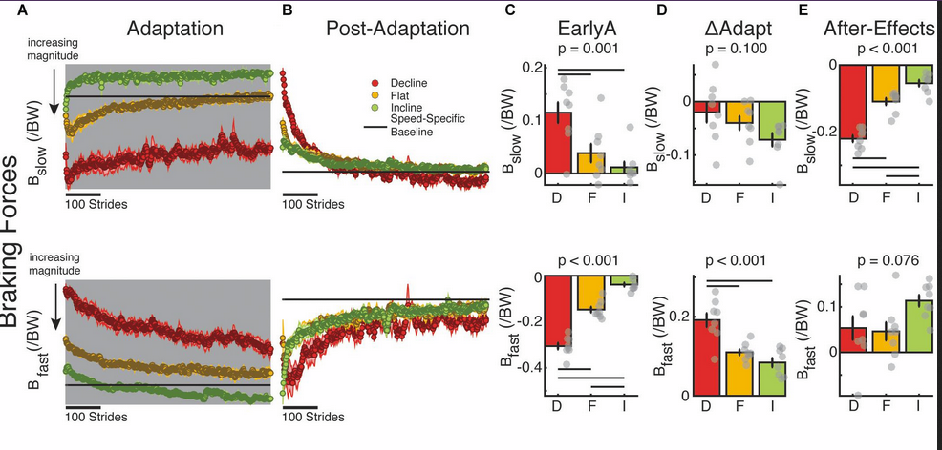
Comparison of braking force to data from “Large propulsion demands increase locomotor Adatptation at the expense of step length symmetry” (Sombric, Calvert, Torres-Oviedo) 2019. – mine is normalixed to mass right now, can change that

Slide 9
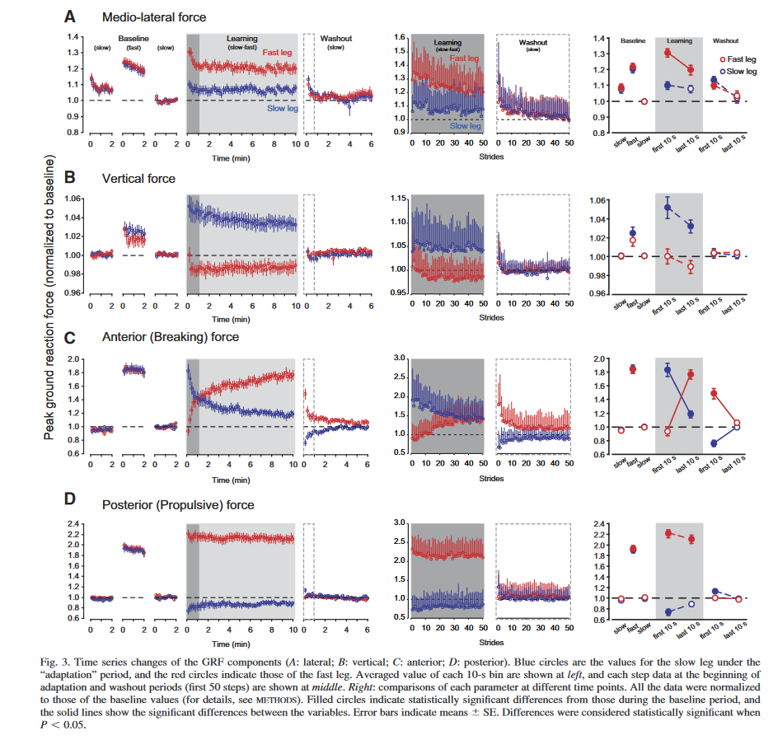
Ogawa, T., Kawashima, N., Ogata, T., and Nakazawa, K. (2014). Predictive control of ankle stiffness at heel contact is a key element of locomotor adaptation during split-belt treadmill walking in humans. J. Neurophysiol. 111, 722–732. doi: 10.1152/jn.00497.2012
EXTENSIVE NOTES IN ZOTERO
Observed adaptation and after-effects in braking force but not in propulsive force
Propose that braking force is the predictive feedforward component of split belt, while propulsive forces are reactive
Noted largest change in braking on the slow leg and propulsion in the fast leg

Slide 10
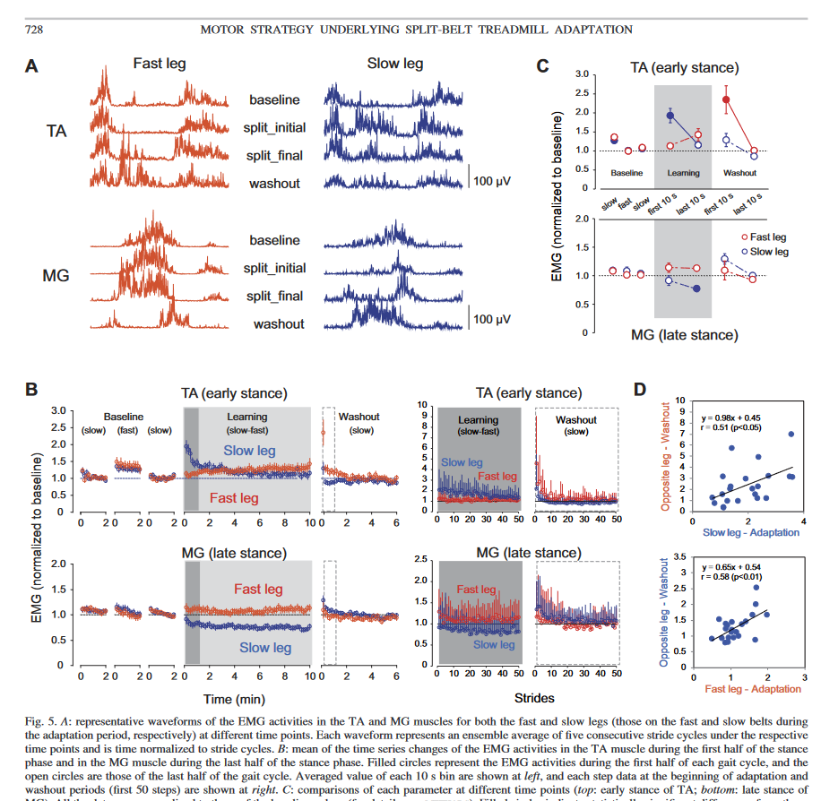
Ogawa, T., Kawashima, N., Ogata, T., and Nakazawa, K. (2014). Predictive control of ankle stiffness at heel contact is a key element of locomotor adaptation during split-belt treadmill walking in humans.
TA is active in swing and early stance (braking) during normal walking while the MG is active in late stance (propulsion)
During adaptation TA activity lengthens to full stance
Propose that increased TA activity means ankle stabilization during stance on slow leg

Slide 11
To compare my data to this paper
Normalize to GRF during slow baseline (rather than to bodyweight)
in our case this will remove the magnitude difference (though not other potentially interesting differences) between effort groups
Compare braking and propulsive adaptation data to theirs
our control data is a near identical procedure (except treadmill moved continuously in theirs)

Slide 12
Braking and propulsion forces
Me
Normed to slow baseline
BRAKING
Slow leg braking force decreases (consistent with Ogawa - and Sombric – the curves are opposite because of normalization differences)
fast leg braking increases (constistent with Ogawa)
Paper
Note the differences in braking on the slow leg between effort groups
PUSH OFF
Observed slight increase in fast leg propulsion, consistent with the Sombric data
Observed aftereffects on both legs, consistent with Sombric but not Ogawa, though no characteristic adaptation, consistent with Ogawa proposal of propulsion as reactive
Sombric 2019
Normed to bodyweight
Ogawa 2014
Normed GRF to slow walking GRF
Fast leg in red

Slide 13
Group differences in slow leg braking during first exposure
Control and low effort groups increase braking more in early adaptation and decrease it more slowly
Fast leg braking appears similar between groups

Slide 14
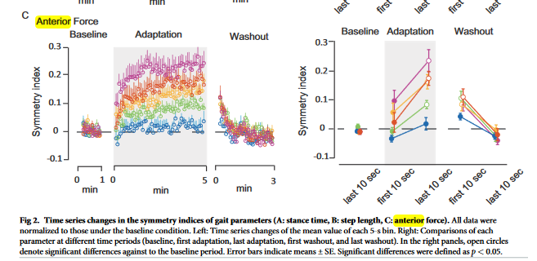
Yokoyama, Sato, Ogawa, Yamamoto, Nakazawa, Kawashima. Characteristics of the gait adaptation process due to split-belt treadmill walking under a wide range of right-left speed ratios (2018)
Observed positive and increasing asymmetry in the braking force (relatively more braking in the fast leg and increasing fast-leg braking reliance over the course of adaptation)

Slide 15
Finely 2013
Reduction in metabolic cost
increased stability? (Ankle stiffness observed by Ogawa?

Slide 16
Hookgamer 2015
Perception of difference in belt speeds modulates adaptation

Slide 17
On Nonlinear Regression for Trends in Split-belt treadmill training
Rashid, Kumari, Signal, Taylor, Vandal
2020 brain sciences
Single and double exponential models fitted to steplength are limited (optimization requires good initial guess; R2 is used to compare, but is not a valuable metric for nonlinear regressions; inference is based on comparison of confidence intervals that assume a nonlinear model has a good linear approximation)
Parameter bounds for exponential models that allow the use of particle swarm optimization without initial guess; AIC for comparison; Confidence interval method that does not rely on linear approximation assumption

Slide 18
To do
Dip in control group symmetry plot for braking?
~300 steps in all 10 and 15 min blocks, should be closer to 600 in 10 min and 800 in 15 minute (very slow) so what is happening? Does this happen during heel strike validation?
Validated are mostly close to the number of heel strikes recorded, step numbers are low in washout, but 0.5 m/s is very slow
=> trimming is happening later…maybe in asymmetry measure creation

Slide 19
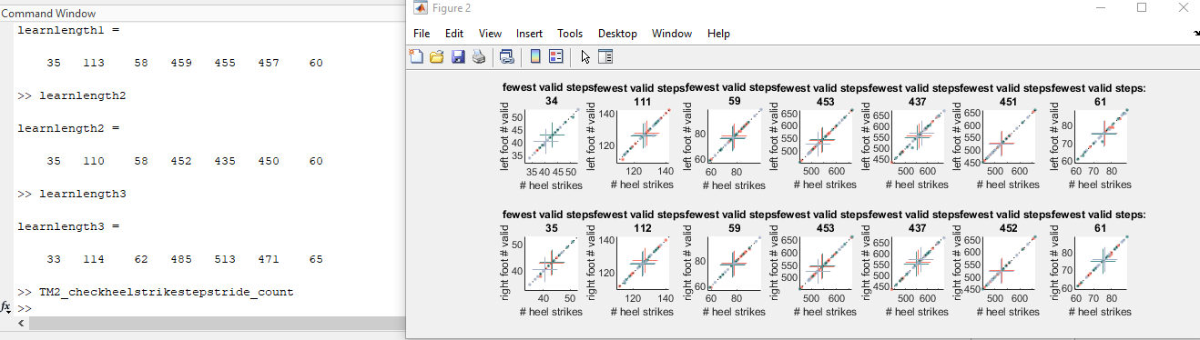
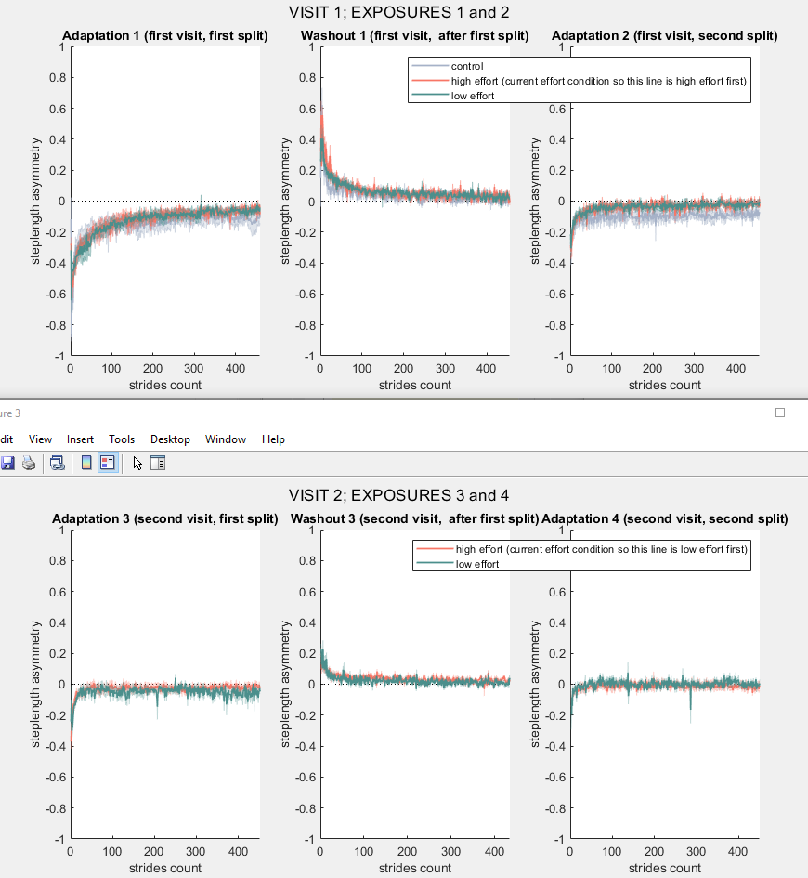
To do
~300 steps in all 10 and 15 min blocks, should be closer to 600 in 10 min and 800 in 15 minute (very slow) so what is happening? Does this happen during heel strike validation?
Validated are mostly close to the number of heel strikes recorded, step numbers are low in washout, but 0.5 m/s is very slow
SUBJ 7 has the lowest # of steps (CFL) – this subject was also very tall (6’2”)
=> trimming is happening later
The lengths in TM2_05, as well as the plots look pretty good
Check asymmetries in TM2_04 (plots should be moved to a TM2_05, only the calculation should happen in TM2_04)
Values in asymlengthy in TM2_04 force and impulse are lower than the validated step counts – this value is the minimum length of valid steps
Identified a NaN trimming command causing the problem, resolved with NaN trim removal, but where are the NaNs coming from?
Cell structures for trimming into strides output sdRy and sdLy contain a series of constant vales at the end (43 – 78 in the example case) so that the calculated stride max min and impulse cannot be calculated
Getting a string of the same index values at the end of hsidx – this was because the time vector did not increase monotonically. Time has been assigned to NaN after a dt < 0 is detected – this happens in getStrideDataCell_valid, but this could probably be taken care of in TM2_01
Ugh, would have to be in TM2_00
Added to TM2_02b – all the blks are processed for heelstrikes, and that data is dependent on time, so this should be early enough to see if it causes problems
Works => trimming issue is resolved, getting about 450 steps for each of the longer blocks

Slide 20
Differences in step length symmetry for the control group?

Slide 21
Learning
WSN driving the dip at 150 steps and driving the differences observed in symmetry between control and effort groups (for step length)

Slide 22
Readaptation / Savings

Slide 23
8 August
Trimming issue resolved, there was an error in the step alignment code that resulted from nonmonotonic time vectors
(not sure how this is possible as time is defined as length(data)*fs)
Now the time vectors are checked for monotonicity in TM2_02b_identifyheelstrikes
Unilateral step length analysis
Last week noted the shift in braking force from higher in slow leg to higher in fast leg – hypothesized that this was related to decrease in slow leg step length decreasing
In initial adaptation, the slow leg is 50% longer and the fast leg is 50% shorter step
Over adaptation, both approach their baseline slow step length
fast leg reaches the baseline slow length
The slow leg reaches steady state at a step length ~20-25% longer than baseline slow
(all numbers are visual approximations)
Based on this data, the change in braking forces may be more associated with the adapation of the fast leg (a greater adaptation extent) than on the slow leg
Unilateral step time analysis
In step time, asymmetry curves, very rapidly become positive and stay that way over the course of adaptation. Based on the way symmetry has been defined, positive asymmetry indicates longer step time for the FAST leg
Consistent with this finding, we have longer step times for the fast leg which very gradually increase over the adaptation

Slide 24
8 August cont. differences between groups?
Unilateral step length differences between groups?
Last week, we had noted the possible divergence in braking forces between the high effort group and the control and low effort groups at the end of adaptation
In step length there is a suggestion of differential steady state values between groups, especially in the slow leg where the control group seems to have a longer slow step than the other two groups
Possible differences in early adapation in the fast leg – btw control and the two other groups where control would be adapting faster – seems likely to go away with more data
In step time, it seems that the control group more rapidly reaches the steady state asymmetry with the fast leg
But this is driven by 1 or 2 individuals (HKS and NVN)
### need to go back and check for tripping / step validity

Slide 25
Total subjects: 22; High first group: 6; Low first group: 8; Control group: 8
Total right leg fast: 11; Total left leg fast: 11
n high right: 3; n high left: 3; n low right: 4; n low left: 4; n control right: 4; n control left: 4

Slide 26
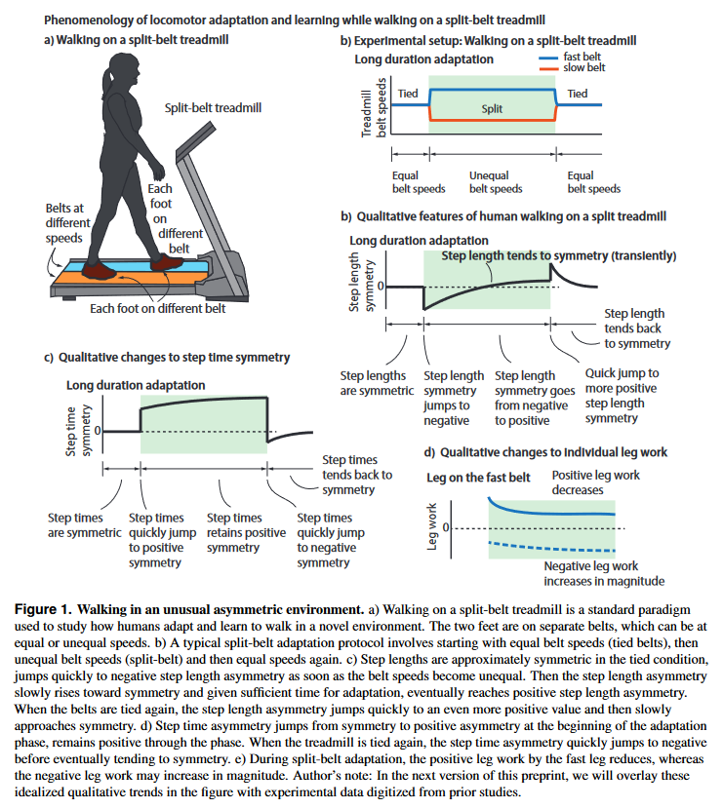
Good sample figure from Exploration-based learning of a step to step controller predicts locomotor adaptation, 2021 Srinivasan

Slide 27
Follow Up Experiment : VMR Effort and Learning
Proposal
Add a “steeper” effort penalty
Add a second gradient effort group where lower initial angles are more costly
Give only crossing point feedback
Remove tone and flash
credit assignment or secondary learning problem
Simplest - tell subjects that the change in effort on the next reach is related to the prior reach (neutral word here) - how do we control for this instruction in the constant group?
Online effort cost could be tried
Reach sufficient to capture real-life changes movement behaviors
Increase reach circle diamete?r
35
b
20
5
Is this changing too many things at once?
error
crossing point cursor feedback (+/- 1.5 cm)?
Neutral crossing point tone
Increase target circle diameter as much as the display permits
cursor feedback within 3 cm of target on return mvt

Slide 28
Follow Up Experiment : VMR Effort and Learning
Proposal
Add a “steeper” effort penalty - and more steeply penalize small errors - logistic landscape
Add a second gradient effort group where lower initial angles are more costly
Give only crossing point feedback
This remains visible until they are back in the home circle
Remove tone and flash - beep 2 for all
Credit assignment or secondary learning problem
Two groups, one that is told that the resistance is related to their performance and one that is not
Reach sufficient to capture real-life changes movement behaviors
Increase reach circle diameter to 15 cm - 13 in code now (15 circle was too big)
Reduce target size to 1 cm
35
b
20
5
Is this changing too many things at once?
error
crossing point cursor feedback (+/- 1.5 cm)?
Neutral crossing point tone
Increase target circle diameter as much as the display permits
cursor feedback within 3 cm of target on return mvt

Slide 29
9 August
The time “oscillations” where the last couple time points would jump back and forth as if unstable was introduced in the resample in TM2_00_Load, when time = (1:size(Fdata,1))/fs; is resampled to be at 100 Hz instead of 1000Hz
There is no oscillation prior to resample, but there is afterward. The time vector based on the marker data is never resampled and does not show this error
This is legacy code from viconstarter and should be updated throughout
Fixed in my code now (so new subjects will be loaded correctly
All subjects have been reloaded to correct F(subj).time for all subjects
The hack fix in TM2_02 has been removed

Slide 30
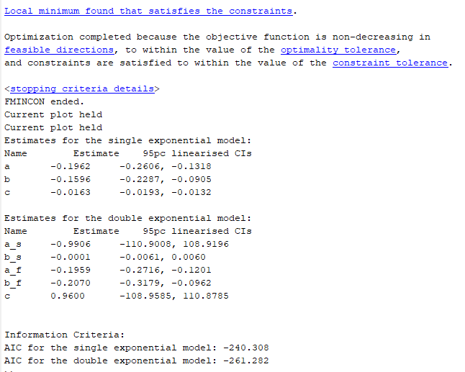
On Nonlinear Regression for Trends in Split-belt treadmill training
Rashid, Kumari, Signal, Taylor, Vandal
2020 brain sciences
Single and double exponential models fitted to steplength are limited (optimization requires good initial guess; R2 is used to compare, but is not a valuable metric for nonlinear regressions; inference is based on comparison of confidence intervals that assume a nonlinear model has a good linear approximation)
Parameter bounds for exponential models that allow the use of particle swarm optimization without initial guess; AIC for comparison; Confidence interval method that does not rely on linear approximation assumption
This paper identifies short comings in the nonlinear regression and then details a pipeline to mitigate the points where error (based on initial value bias or violated assumptions) occurs
This paper does not use NLMER
The pipeline is posted to GitHub and the code there:
Sets parameter boundaries such that the solution space is fully explored based on direct real life interpretations of the parameters
Uses a particle swarm algorithm (global search) to find a starting point without initial condition bias
Uses gradient optimization to identify the parameter values
Repeats those two steps and compares the AIC of the two outcomes, selecting the better AIC
Generates confidence intervals without assuming linearization
They use for both group and individual asymmetry data in their examples (noting that it did not work for 2/30 individuals)
For subject 1; effort condition 1; block 4 (Adaptation on SECOND visit)

Slide 31
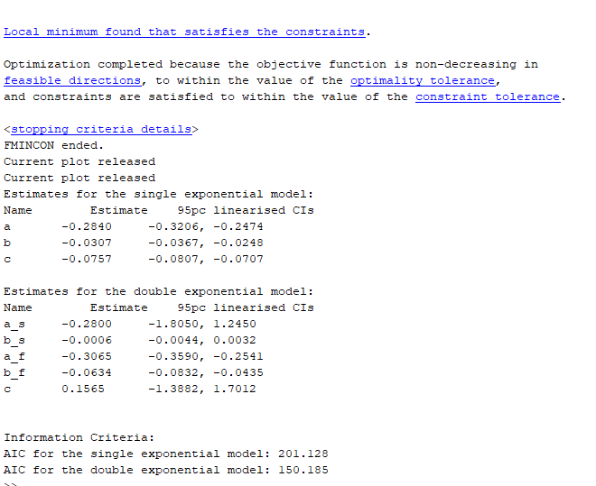
Subject1; effcond 2; blk 4 (this was adaptation on FIRST visit)

